Slide 1

MSE 311: Thermodynamics of Materials
Lecture-04/05:
Heat engine
2022 Fall
Weishu Liu
Department of Materials Science and Engineering
Southern University of Science and Technology (SUSTech)
Email: liuws@sustech.edu.cn
Office: North Tower，Rm310
Sep 7，2018
Prof. W.S. Liu | 1

Slide 2
6. Work done by Compressed air
Ref. Thermodynamics: A Engineering approach, Chapter 9

Slide 3
Exergy: Work Potential of Energy
Work potential of a system: the amount of energy we can extract from the system to do useful work.
Dead state: a system is in thermodynamic equilibrium with the environment it is in.
System delivers the maximum possible work as it undergoes a reversible process from the specified initial state to the state of its environment, that is, the dead state. This represents the useful work potential of the system at the specified and is called exergy.
Exergy is a system-environment combined property.
The exergy of a system in the dead state is zero.

Slide 4


Exergy from Different Energy
2nd law：
1st law:
The Exergy:

Slide 5
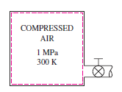
Exergy of compressed air
Problem: A 200-m³ rigid tank contains compressed air at 1 MPa and 300 K. Determine，how much work can be obtained from this air if the environment conditions are 100 kPa and 300 K.
The mass of air in the tank
Air: 28.97 g/mol
0
0
0
Yunus A. Cengel, Thermodynamics: A Engineering Approach, 8th version Page 437

Slide 6
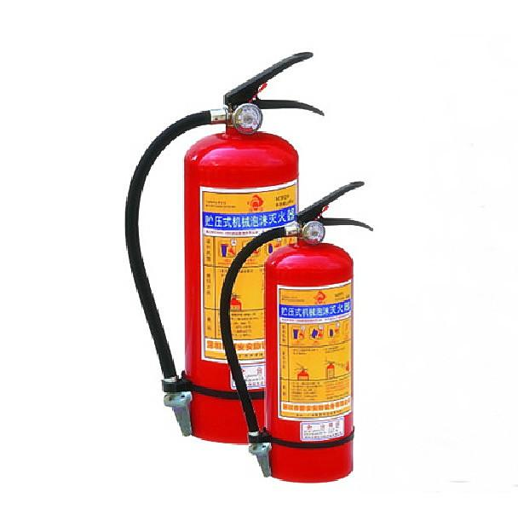
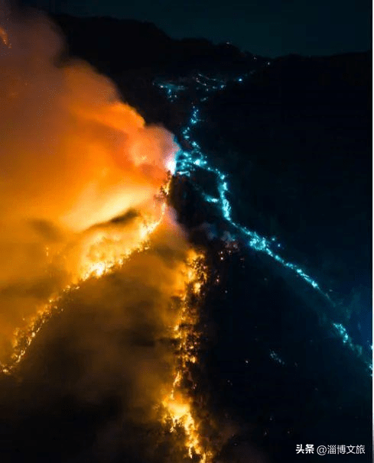
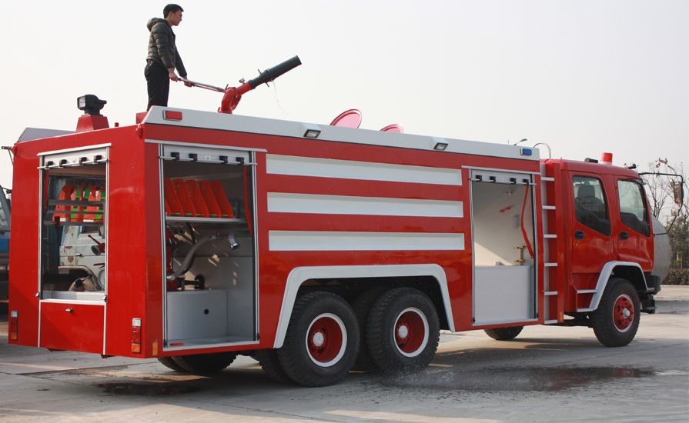
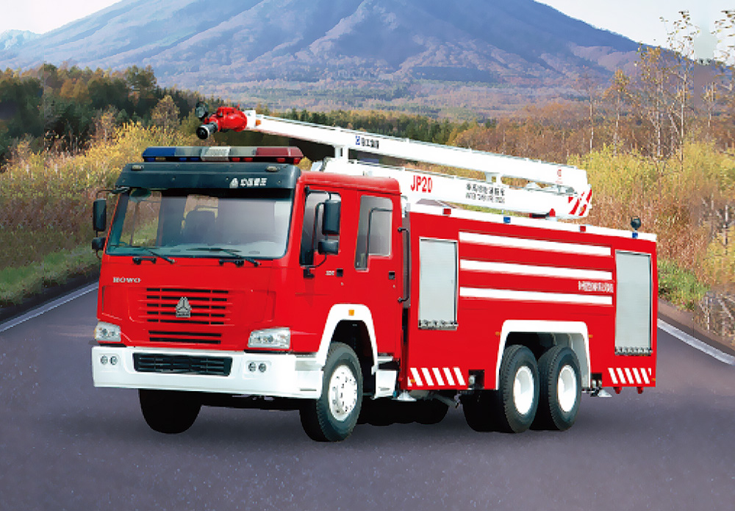
Application of compressed air
灭火器
泡沫消防车
高喷消防车

Slide 7
7. Otto cycle
Ref. Thermodynamics: A Engineering approach, Chapter 9

Slide 8
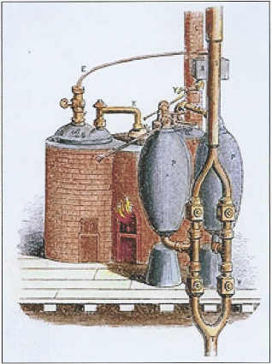
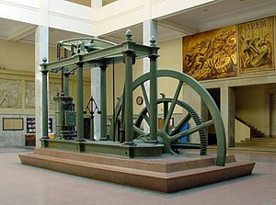
A history of Heat Engine
1769, James Watt patents his first improved atmospheric steam engine, doubling the efficiency of earlier engines.
1698 Thomas Savery: a pistonless steam-powered water pump for pumping water out of mines
Figures from wikipedia

Slide 9
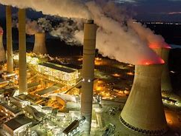
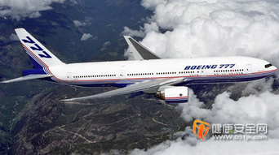
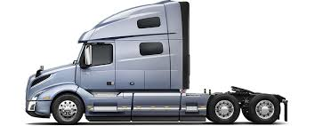
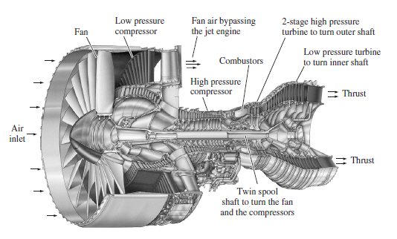
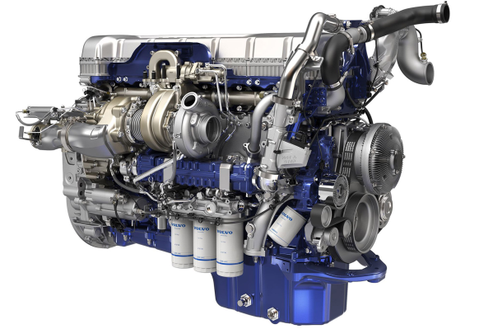
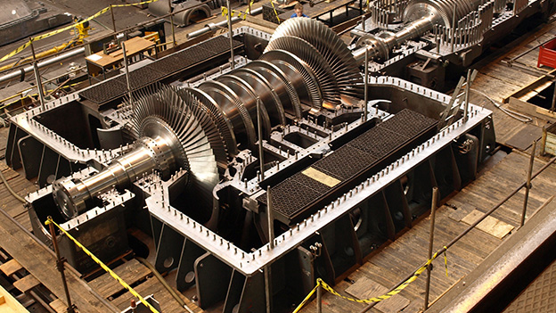
Heat Engine
in power plant, airplane and truck
Figures from internet

Slide 10
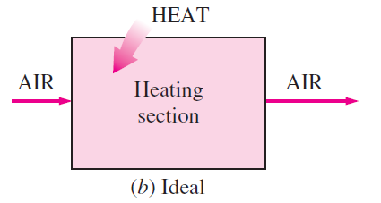
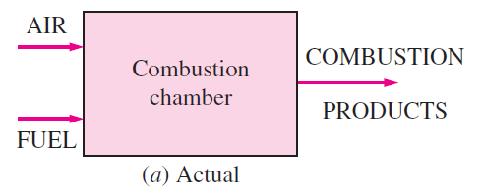
Air-standard assumptions
Internal combustion engines with gas power cycles: spark-ignition engine, diesel engines, conventional gas turbines
Air-standard assumptions:
Working fluid is air: closed loop, ideal gas;
Internally reversible;
Combustion = heat addition from an external source;
Exhaust = heat rejection that restores working fluid to its initial state.
Cold-air-standard assumptions: air has constant specific heat whose values are determined at room temperature (25 °C)

Slide 11
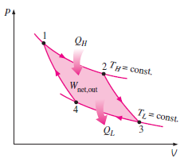
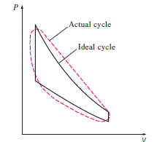
Power cycles: idea vs. real
Idealization of cycles -- Internally reversible: No irreversibilities occur within the boundaries of the system during the process.
No friction; Expansion/compression in quasi-equilibrium manner; No heat leakage through pipes (absolutely insulated); Neglect kinetic & potential energy changes

Slide 12
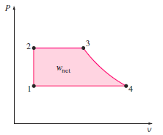
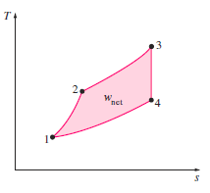

P-V diagram and T-S diagram

Slide 13
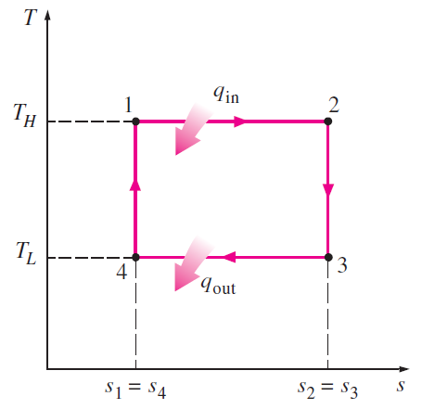

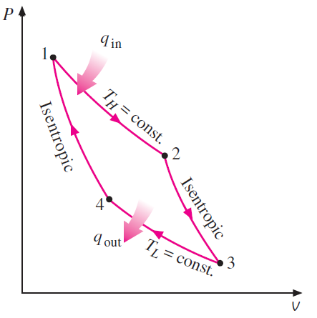





Carnot Cycle in T-S diagram
Reversible isothermal heat transfer is very difficult to achieve in reality

Slide 14
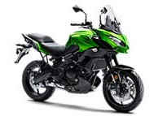
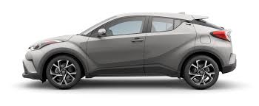
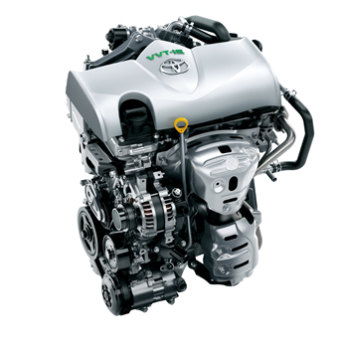
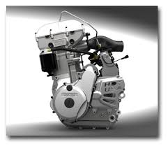
Reciprocating Engine Overview

Slide 15
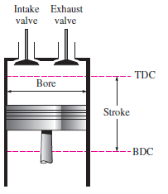
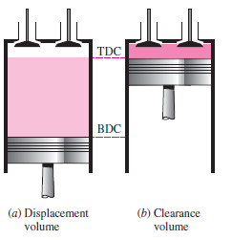

Reciprocating Engine Overview
Compression ratio r
TDC: top dead center; BDC: bottom dead center; Stroke: largest distance that piston can travel; Bore: piston diameter;
Intake valve; Exhaust valve; Clearance displacement; Displacement volume;

Slide 16
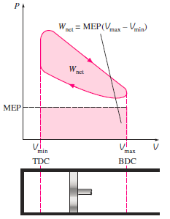


Reciprocating Engine Overview
MEP: mean effective pressure

Slide 17
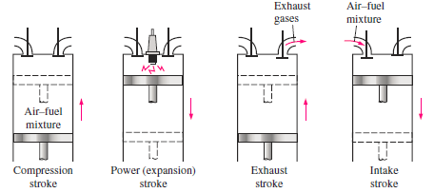
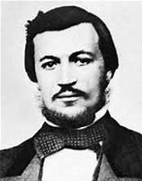
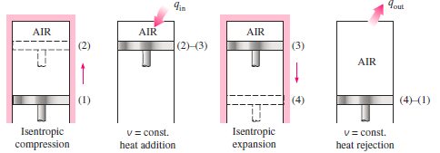
Otto Cycle
——Spark-Ignition (SI) Engine
Otto cycle:
after Nikolaus A. Otto
MSE 5006 | 17

Slide 18
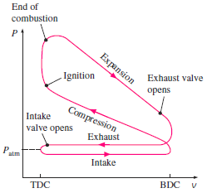
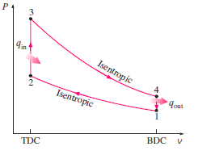
Otto Cycle
——Spark-Ignition Engine
Simplification

Slide 19
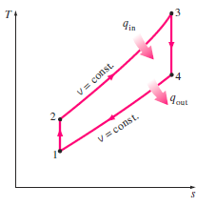



Otto Cycle
——Spark-Ignition Engine
1-2: Isentropic compression;
2-3: Constant-volume heat addition;
3-4: Isentropic expansion;
4-1: Constant-volume heat rejection

Slide 20



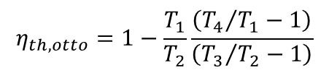
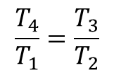
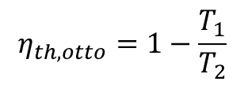
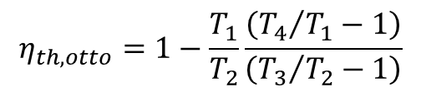
Otto Cycle
—— Spark-Ignition Engine
Isentropic, and v₂=v₃ and v₄=v₁
$$\frac{T_{4}}{T_{1}}=\frac{T_{3}}{T_{2}}$$
$$η_{th,otto}=1−\frac{T_{1}}{T_{2}}\frac{\left({T_{4}}/{T_{1}}−1\right)}{\left({T_{3}}/{T_{2}}−1\right)}$$
$$η_{th,otto}=1−\frac{T_{1}}{T_{2}}$$
$$η_{th,otto}=1−\frac{T_{1}}{T_{2}}\frac{\left({T_{4}}/{T_{1}}−1\right)}{\left({T_{3}}/{T_{2}}−1\right)}$$

Slide 21
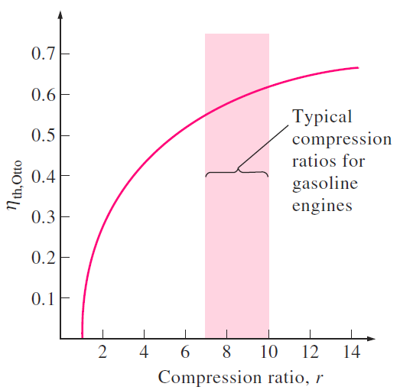
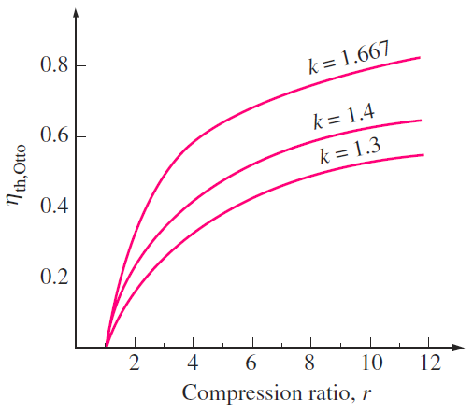
Otto Cycle
——Spark-Ignition Engine
Compression ratio, r
Specific heat ratio, k=C_{p}/C_{v}
k = 1.4 (air at RT)
k = 1.667 (Ar or He)
k = 1.3 (CO₂)
k = 1.2 (CH₃CH₃)
Actual spark-ignition engines η = 25-30%

Slide 22
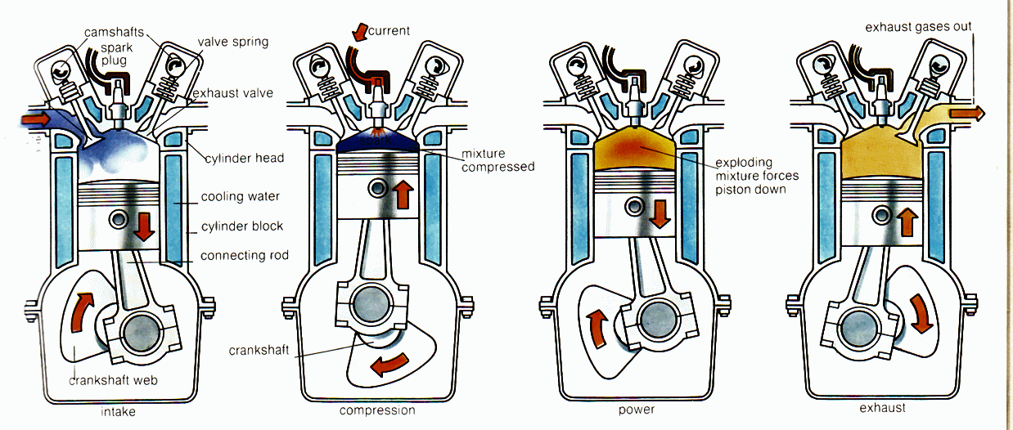
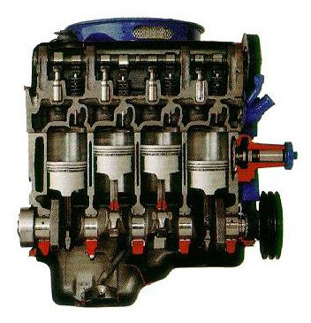
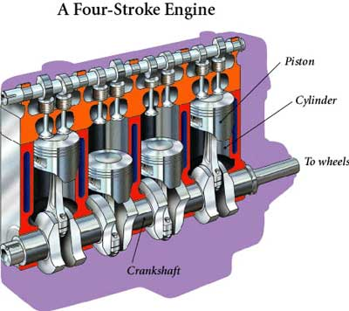
What is the challenge in a Otto engine?

Slide 23
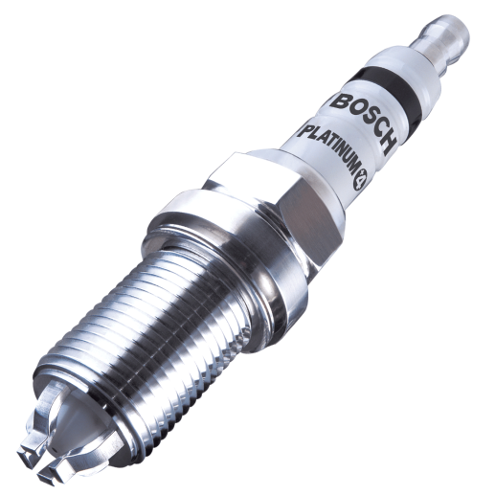
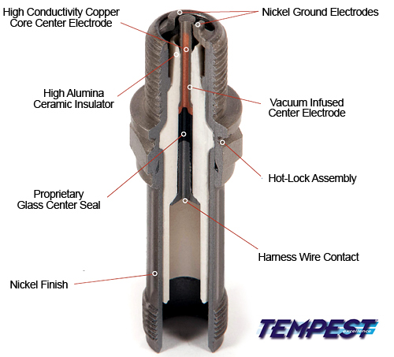
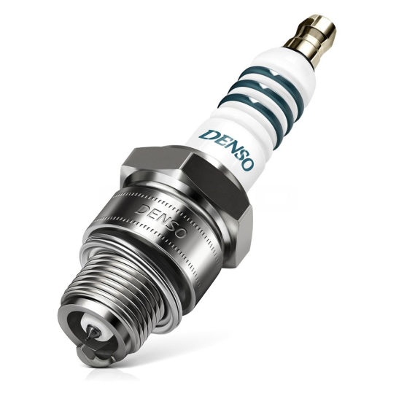
The heart of the Otto engine: spark plug
Bosch
Germany
Denso
Japan
Open question: Why is it challenge?

Slide 24
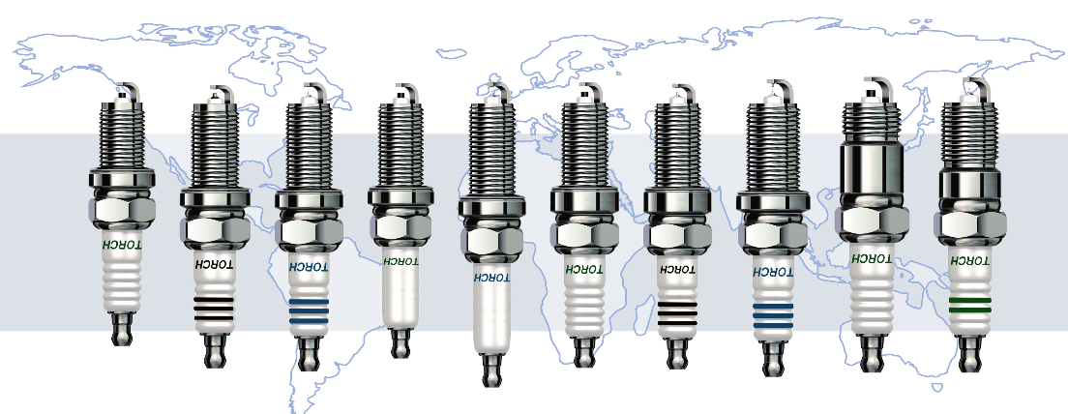

Spark plug: Made in China
潍柴火炬科技股份有限公司
Torch已跻身全球十大火花塞品牌，成为国内产量最高的火花塞研发生产基地。重点产品是质量好、耐磨的铂铱火花塞
1961, 创立于湖南省株洲县渌口镇，前身渌口内燃机配件厂，隶属农机部，后更名为株洲火花塞厂
2005年，潍柴动力吸收合并湘火炬，现为潍柴动力属下具有独立法人资格的全资子公司。
2006年，收购美国DELPHI火花塞工厂全套设备和技术专利, 年产能提升至2亿只，同时实现了点火系统模块化发展。

Slide 25
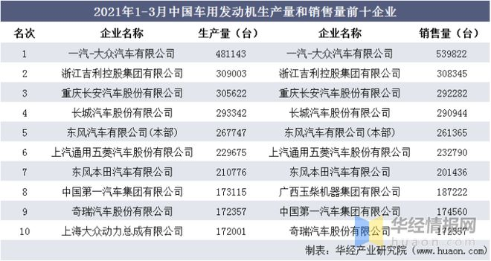
Otto Engine: Made in China

Slide 26
8. Diesel cycle
Ref. Thermodynamics: A Engineering approach, Chapter 9

Slide 27
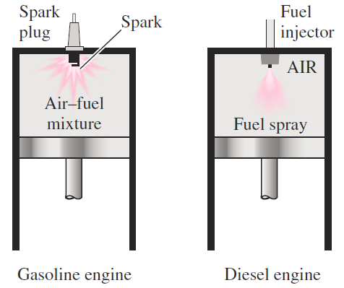
Diesel Cycle
——Combustion-Ignition (CI) Engine
After Rudolph Diesel

Slide 28
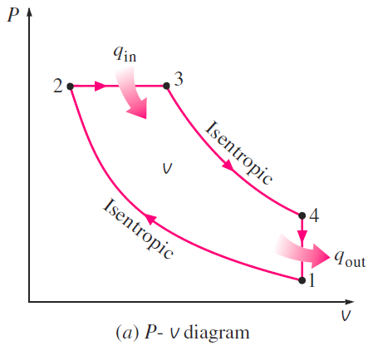



Diesel Cycle
——Combustion-Ignition Engine
Diesel cycle
Diesel cycle
1-2: Isentropic compression;
2-3: Constant-pressure heat addition;
3-4: Isentropic expansion;
4-1: Constant-volume heat rejection
Otto cycle

Slide 29





Diesel Cycle
——Combustion-Ignition Engine
Considering isentropic 1→2 and 3→ 4
Considering const P from 2→ 3
$$\begin{matrix}T_{1}V_{1}^{k−1}=T_{2}V_{2}^{k−1} \\ T_{4}V_{4}^{k−1}=T_{3}V_{3}^{k−1} \\ \frac{T_{4}V_{4}^{k−1}}{T_{1}V_{1}^{k−1}}=\frac{T_{3}V_{3}^{k−1}}{T_{2}V_{2}^{k−1}}⇒\frac{T_{4}}{T_{1}}=\frac{T_{3}V_{3}^{k−1}}{T_{2}V_{2}^{k−1}}⇒\frac{T_{4}}{T_{1}}=\frac{T_{3}}{T_{2}}r_{c}^{k−1}\end{matrix}$$
$$\begin{matrix}\frac{T_{3}}{T_{2}}=\frac{v_{3}}{v_{2}}=r_{c} \\ \frac{T_{4}}{T_{1}}=\frac{v_{3}}{v_{2}}γ_{c}^{k−1}\end{matrix}$$
Cutoff ratio r_{c}

Slide 30

Diesel Cycle
——Combustion-Ignition Engine
With same r,
η_{th,Otto} > η_{th, Diesel}
r_{c} ↑, η_{th, Diesel} ↓
r_{c} = 1, η_{th,Otto} = η_{th, Diesel}

Slide 31

Diesel Cycle
High speed Combustion-Ignition Engine
Ideal dual cycle
Advantages of diesel engines: much higher r → much higher η (35-40%)
Burn fuel more completely: lower revolution/cycle, higher air-fuel ratios
Applications requiring large amount of power: locomotive, large ships, heavy trucks

Slide 32




Otto and Daimler
The 1860 Lenoir Engine, ran on illuminating gas at 4% efficiency
A 1880s era Otto Engine for Stationary Use
1885 Daimler's Petroleum Reitwagen
1885 Benz Patent Motorwagen

Slide 33




Otto and Daimler
1862 First experiments with four-stroke engines
1864 Establishing the first engine factory in the world: NA Otto Cie
1867 Gold Medal of the World Exhibition in Paris for the gas engine
1869 The company relocates and changes its name to Langen, Otto, and Roosen
1872 The company relocates to larger facilities and changes it name to Deutz Gasmotoren Fabrik
1876 Development of four-stroke engine (Otto-motor)
1882 Production of the Atmospheric engine is discontinued after 2649 were made
1882, Independent inventor of small, high speed engines
1883, Daimler and Maybach patented the first of their engines fueled by ligroin
1885 Grandfather clock engine
1886 First automobile , Carl Benz and Gottlieb Daimler each produced an automobile in 1886, both in Germany, about 60 miles apart
1926 Benz & Cie. and Daimler Motoren Gesellschaft formally merged - becoming Daimler-Benz AG , Later the company ‘s name was changed into Mercedes-Benz

Slide 34






Diesel Engine: Made in China
上东潍柴
广西潍柴
日本洋马
日本五十铃
美国康明斯

Slide 35
Power cycles
Otto Cycle
Diesel Cycle
r_{c} = 1, η_{th,Otto} = η_{th, Diesel}

Slide 36


Power cycles
Book Reading
(c) Ericsson Cycle

Slide 37


Stirling engine: harvest solar energy

Slide 38


300 MW commercial solar thermal power plant in California

Slide 39
9. Brayton Cycle
（燃气轮机）
Ref. Thermodynamics: A Engineering approach, Chapter 9,17

Slide 40

gas tube engine of GE

Slide 41


Brayton Cycle
1870, The Brayton cycle was first proposed by George Brayton for the use in the reciprocating burning engine.
Now, it was used for the gas tube engine.
History about the gas turbo engine.
1791 First patent for a gas turbine (John Barber, United Kingdom)
1904 Unsuccessful gas turbine project by Franz Stolze in Berlin 1906 GT by Armengaud Lemale in France
1910 First GT featuring intermittent combustion (Holzwarth, 150 kW, constant volume combustion)
1923 First exhaust-gas turbocharger to increase the power of diesel engines
1939 World’s first gas turbine for power generation (Brown Boveri Company), Neuchâtel, Switzerlan

Slide 42






Brayton Cycle
Brayton Cycle
1→2: isentropic compression
2→3: const. pressure
3→4: isentropic expansion
4→1: const press (heat reject)
Pressure ratio
$$r_{p}={P_{2}}/{P_{1}}$$

Slide 43

Limitation of the highest temperature
The highest temperature in the cycles occurs at the end of the combustion process (state 3)
It is limited by the maximum temperature of the turbine blade can withstand.

Slide 44


Slide 45



Brayton Cycle with Regeneration

Slide 46


Efficiency of gas turbine engine
GE LM2500, for ship
Efficiency: 37%
Power: 25 MW
Exhaust gas: 566°C
Rolls-Royce WR-21
Efficiency: 43%
Power: 21.6
Exhaust gas: 566°C

Slide 47

Application of gas turbine
Gas turbine engines are used for electric power generation and aircraft propulsion
For the aircraft, gas turbine produce small part power to drive the compressor, while the high velocity exhaust gas for producing the thrust to propel the aircraft.
The aircraft gas turbine operate at a high pressure ratio of 10-25

Slide 48
Jet-propulsion cycles
The pressure of air pressure rise as it decelerated in the diffuser.
Air is compressed by the compressor. It is mixed with fuel in the combustion chamber, where the mixture is burned at constant pressure.
The high pressure and high temperature combustion gases partially expand in the turbine, producing enough power to drive the compressor and other equipment.
The gases expand in a nozzle to the ambient pressure and leave the engine at a high velocity.

Slide 49

Jet-propulsion cycles
The thrust developed in a turbine engine is the unbalance force that is caused by the difference in the momentum of the low-velocity air entering the engine and the high-velocity exhaust gases leaving the engine.
It is determined by Newton’s second Law.
The mass flow rate of the gases at the engine exit and inlet are different, the difference being equal to the combustion rate of the fuel.
The air-fuel mass ratio is usually very high, making the difference is small.
The $\dot{m}$ is taken as the mass flow rate of the air through the engine.

Slide 50


Stagnation enthalpy
Enthalpy, H = U + PV
For high speed flow, the kinetic energy is not negligible
Stagnation Enthalpy (滞止焓), H ₀= H+ mv²/2
It means the entropy of a flow when it is brought to rest adiabatically
$$\begin{matrix}h_{01}=h_{1}+\frac{v_{1}^{2}}{2} \\ h_{02}=h_{2}+\frac{v_{2}^{2}}{2}\end{matrix}$$
h₁
h₂
$$h_{01}{=h}_{02}$$
v₁
v₂
Steady flow in a adiabatic duct
Ref. Thermodynamics: A Engineering approach, Chapter 17

Slide 51




Stagnation temperature
Stagnation temperature, T₀
Stagnation pressure, P₀
$${\left(\frac{P_{0}}{P}\right)=\left(\frac{T_{0}}{T}\right)}^{k/{\left(k−1\right)}}$$
Compressor
An aircraft is flying at a cruising speed of 250 m/s at a altitude of 5000m where the atmospheric pressure is 54.5 kPa and the ambient temperature is 255.7K.
Assume both the diffuser and the compressor are isentropic. c_{p}=1.005 kJ/kg.K, k=c_{p/}c_{v}=1.4
The stagnation pressure at the inlet of the compressor
The required compressor work per unite mass if the stagnation pressure ratio is 8
diffuser
T =255.7K
P =54.5 kPa
v=250 m/s
P₀₁
T₀₁
P₀₂
T₀₂
For T₀₂
T₀₁=286.8K
$${8=\left(\frac{P_{02}}{P_{01}}\right)=\left(\frac{T_{02}}{T_{01}}\right)}^{k/{\left(k−1\right)}}$$
$${\left(\frac{P_{01}}{P}\right)=\left(\frac{T_{01}}{T}\right)}^{k/{\left(k−1\right)}}$$
T₀₂=519.5K
P₀₁=80.77 kPa
For w,
w=$c_{p}\left(T_{02}−T_{01}\right)$=233.9 kJ/kg

Slide 52
10. Rankine Cycle
Ref. Thermodynamics: A Engineering approach, Chapter 3，10

Slide 53

Rankine Cycle – Steam Turbine Cycle
In 1859,He advanced the study of heat engines by publishing the “Manual of the Steam Engine and Other Prime Movers”， which is know as the Steam Turbine Cycle
Rankine developed a complete theory of the steam engine and indeed of all heat engines.
Together with Rudolf Clausius and William Thomson (Lord Kelvin), he was a contributor to the thermodynamics, particularly focusing on the first of the three thermodynamic laws.
Rankine worked closely with Clyde shipbuilders, especially his friend and life-long collaborator James Robert Napier to make naval architecture into an engineering science
1820-1872
Scottish engineer,
William John Macquorn Rankine
Clausius considered the conversion between heat and work and the flow of heat from high to low temperature in a cyclic process,
Rankine concentrated on the change from kinetic (molecular) to potential energies, and related this change to heat flow by use of his "heat-potential" function.

Slide 54
The legend of William J. M. Rankine
16, Began classes at University of Edinburgh
24, Employed under Locke and Errington on Caledonian Railway project
35, Regius Professor of civil engineering and mechanics at Glasgow University
37, First President of Institution of Engineers and Shipbuilders in Scotland . Awarded Doctor of Laws, Trinity College, Dublin
51, Vice President of Royal Society of Edinburgh
1820-1872
Scottish engineer,
William John Macquorn Rankine
21, Returned to Edinburgh, working with railway companies
21, Fellow of the Royal Scottish Society of Arts
28, Fellow of the Royal Society of Edinburgh
33, Fellow of the Royal Society of London
43, Elected to American Academy of Arts and Science
48, Elected to Royal Swedish Academy of Sciences
38, Published Applied Mechanics
39, Published The Steam Engine and other Prime Movers
42, Published Civil Engineering
46. Published Shipbuilding, Theoretical and Practica
49, Published Machinery and Millwork
50, Published On the mechanical principles of the action of propellers

Slide 55





Vapor Power Cycles
Nuclear Power Plant
Coal Power Plant
Geothermal Power Plant

Slide 56
Compressed
liquid
saturated
liquid
saturated
Liquid-vapor mixture
saturated
vapor mixture
Super heated
vapor

Slide 58


Rankine Cycle
Notes:
Figure 10-2

Slide 59








Energy Analysis

Slide 60
EXAMPLE: The Simple Ideal Rankine Cycle
Consider a steam power plant operating on the simple ideal Rankine cycle.Steam enters the turbine at 3 MPa and 3508C and is condensed in the condenser at a pressure of 75 kPa. Determine the thermal efficiency of this cycle.
SOLUTION A steam power plant operating on the simple ideal Rankine cycle is considered. The thermal efficiency of the cycle is to be determined.
Assumptions 1 Steady operating conditions exist. 2 Kinetic and potential energy changes are negligible.
Analysis
The schematic of the power plant and the T-s diagram of the cycle are shown in Fig. 10–3.
We note that the power plant operates on the ideal Rankine cycle. Therefore, the pump and the turbine are isentropic, there are no pressure drops in the boiler and condenser, and steam leaves the condenser and enters the pump as saturated liquid at the condenser pressure.

Slide 62


Increase Efficiency
Lower condenser temperature
Superheat steam to higher temperatures

Slide 63


Increase Boiler Pressure
Increasing the boiler pressure
A supercritical Rankine cycles

Slide 64
Idea reheat Rankine cycles
How can we take advantage of the increased efficiencies at higher boiler pressures without facing the problem of excessive moisture at the final stages of the turbine?
Superheat the steam to very high temperatures before it enters the turbine. This would be the desirable solution since the average temperature at which heat is added would also increase, thus increasing the cycle efficiency. This is not a viable solution, however, since it requires raising the steam temperature to metallurgically unsafe levels.
Expand the steam in the turbine in two stages, and reheat it in between. In other words, modifythe simple ideal Rankine cycle with a reheat process. Reheating is a practical solution to the excessive moisture problem in turbines, and it is commonly used in modern steam power plants.

Slide 65
Open Feedwater Heaters
An open (or direct-contact) feedwater heater is basically a mixing
chamber, where the steam extracted from the turbine mixes with the feedwater exiting the pump.
Ideally, the mixture leaves the heater as a saturated liquid at the heater pressure.

Slide 66
Close Feed Water Heaters
Another type of feedwater heater frequently used in steam power plants is
the closed feedwater heater, in which heat is transferred from the extracted
steam to the feedwater without any mixing taking place. The two streams
now can be at different pressures, since they do not mix

Slide 67


瓦良格号和“库兹涅佐夫”号用的是前苏联研制的TB12型蒸汽轮机，45000马力，足以驱动6万吨的航母达到30节的高航速
我国的051型驱逐舰用的就是TB-8型蒸汽轮机

Slide 68

山东舰用的是我国在TB8基础上发展而来的新型蒸汽轮机，它采用了高热负荷炉膛和内置式过热器，不但减轻了体积重量，而且提升了蒸汽的温度和压力，单机功率提高到5万马力左右，一举超过了TB12，四机并联至少可输出20万马力的功率

Slide 69
Home work
Book reading and answer the question
Why vapor Carnot cycle is almost impossible? What’s the technique challenge?
Open question:
Proposal a new possible strategy to increase the efficiency of Brayton Cycle and Rankine
2. Find a new power cycle and explain the working principle.

